Slide 1
Introduction and Process
Lecture 1
Ruzanna Chitchyan, Jon Bird, Pete Bennett
TAs: Mitch Lui, Craig Barnfield, Kira Clements
Notes:
RC

Slide 2
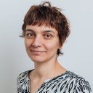





Meet the Team
Lecturers
Ruzanna Chitchyan
Peter Bennett
Jon Bird
Lab Support
Mitch Lui
Craig Barnfield
Kira Clements
Notes:
All

Slide 3
Purpose of Unit
Previous units aim to improve your knowledge as computer scientists
This unit helps package this knowledge as employability skill-sets
This is achieved by targeting the following industry-relevant issues:
Transferable skills: Management, Collaboration, Communication
Platform skills: applying your prior programming language knowledge
Scalability skills: Development “in the large” at industrial scale
Notes:
RC

Slide 4
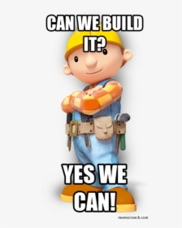
Software Development
But have you heard of Software Crisis
Software is getting larger and larger
Software is getting more complex
Complex domains (e.g., human behaviours)
Systems dependency (e.g., energy and cars)
Time to market is shorter than ever
Notes:
Ruzanna

Slide 5
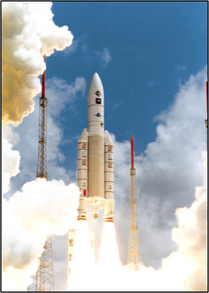
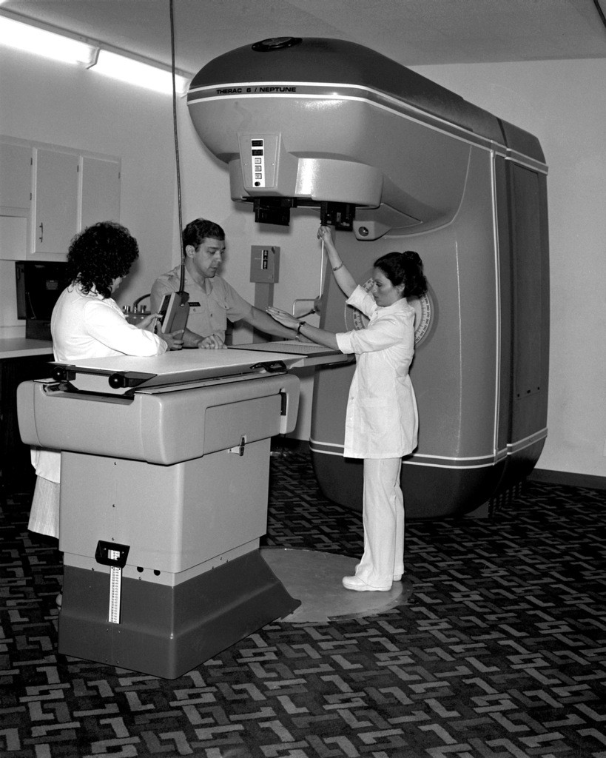
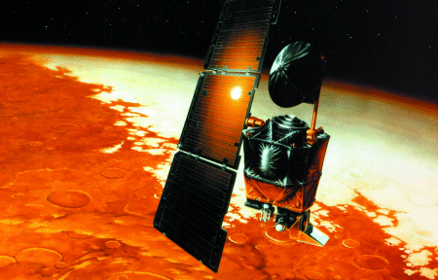
And Projects Fail
Ariane 5 Flight 501
Therac-25 Radiotherapy
Mars Climate Orbiter
Notes:
RC

Slide 6

Why Do Software Projects Fail?
Bad developers – not the main problem!
Over budget
Poor requirements
Over-ambitious requirements
Unnecessary requirements
Contract management
End-user training
Operational management
Notes:
RC

Slide 7
Software Engineering
Software Engineering
Engineering: cost-effective solutions to practical problems by applying scientific knowledge to building things for people
Cost-effective solutions: process and project management, contracts…
Scientific knowledge: modelling, proofs, testing, simulation, patterns...
Things=software
People: customers and end users
Notes:
RC

Slide 8
OK, so how do we do that ?
Notes:
RC

Slide 9
Collaboration Tools and Techniques
UML Designs: Diagramming to reach a consensus on design
GitHub: Sharing of documents for effective collaboration
Kanban: Task allocation and progress monitoring
Test-driven development: Stop other people breaking your code !
Other techniques are encouraged: Feel free to experiment and explore
Notes:
RC

Slide 10
Weekly Themes
Introduction + Overview
Agile Development
Requirements Engineering
Design
Implementation
[Reading Week]
Project Management
Human Computer Interaction: Qualitative Analysis
Human Computer Interaction: Quantitative Analysis
[Easter break: 3 weeks]
Advanced Topics in Software Engineering
Module Closure
Notes:
RC

Slide 11
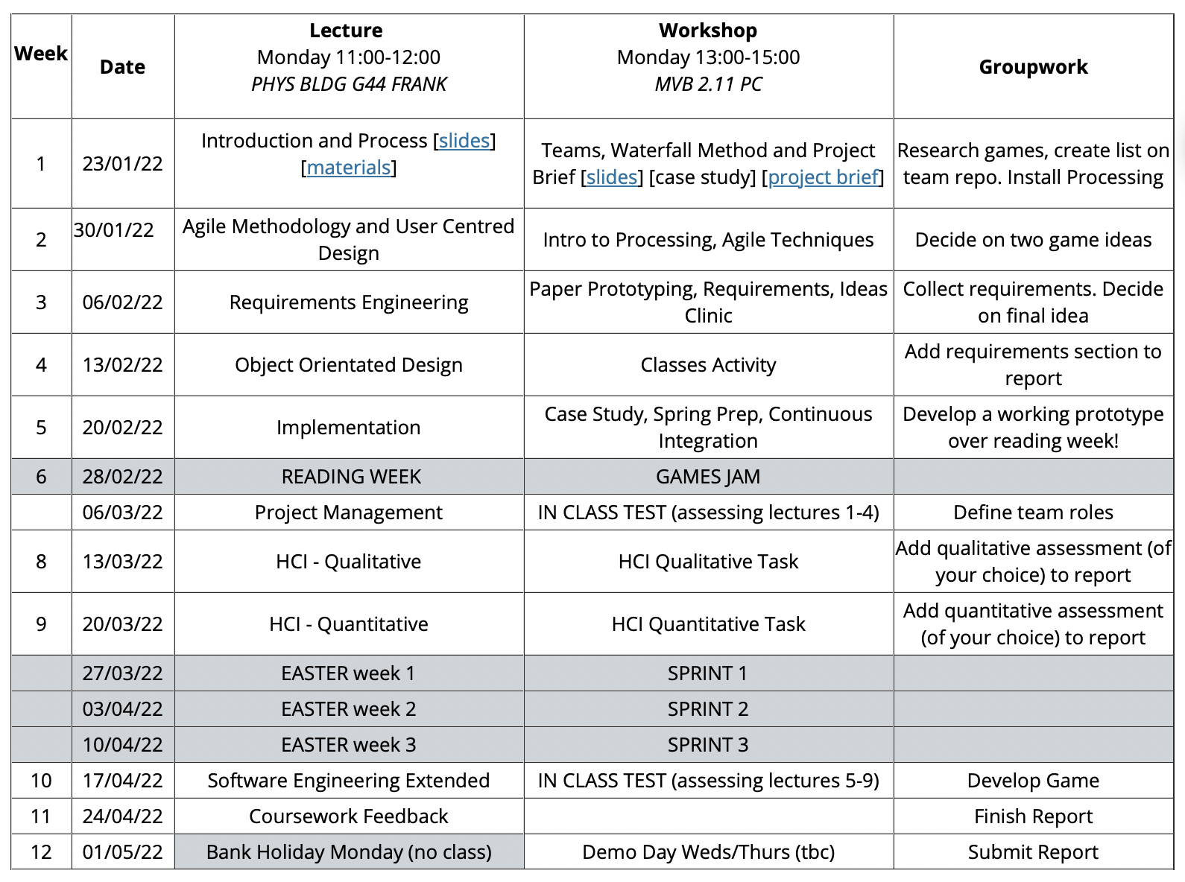
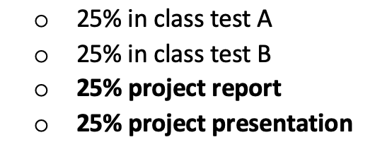
Notes:
RC+PB

Slide 12

Coursework
You get to work on one big project – for the whole term
Apply all of the knowledge you have gained previously…to a significantly sized, real project
Work on the project is structured, We won’t just leave you to get on with it !
Each week you will be given a structured activity, and support will be provided to complete that work
You will be working as part of an integrated development team…
Notes:
PB

Slide 13

Groupwork
We can only hope to tackle a real-world scale application...
....if we work in teams towards the end goal
Working together is also a key transferable skill
In any non-trivial industrial project, you’ll be working in a team (maybe summer project!)
It’s not easy – which is why it is essential to practice now!
Teams of 5 (or 6), assigned randomly
Notes:
PB

Slide 14

“Tasting Stick” Metaphor
All of the previously named techniques are large and complex
We don’t expect you to become experts in everything
The aim is to give you a “taster” of everything
So you can at least be able to say that you have tried them
One way to think of this unit is as a “tasting stick”
Working in groups, individuals are likely to specialise in some aspects
Notes:
PB

Slide 15
What’s Happening This Week?
This week's theme - Introduction and Overview!
Lecture: Grounding of the SE Discipline and Historic View
Introduction to Software Engineering
Waterfall Life Cycle Model
Workshop:
Teams, Waterfall Method and Project Brief
Notes:
pete

Slide 16
Software Development Life Cycle Processes: Which tasks are to be done and in what order?
Notes:
RC

Slide 17
Software Development Tasks
Requirements Analysis
Planning
Design: high level and detailed
Development
Testing
Deployment
Operation and Maintenance
These to-does are combined in various sequences, making up different Software Development Life Cycle Processes
Notes:
Pete

Slide 18
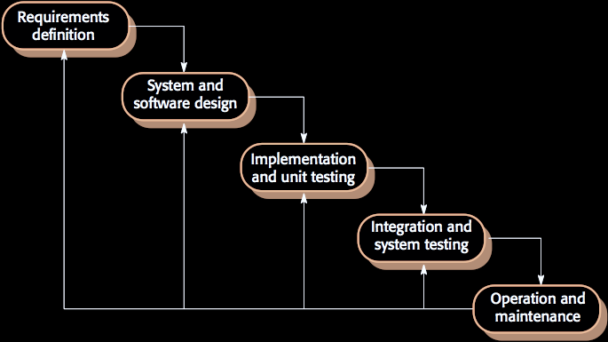
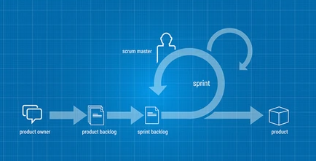
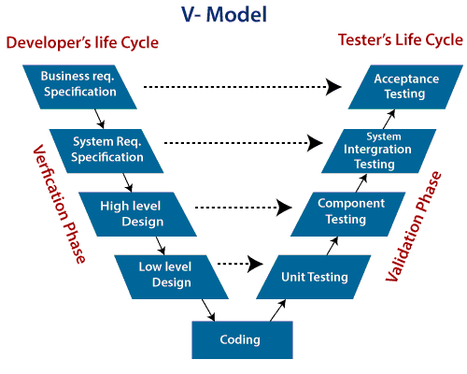
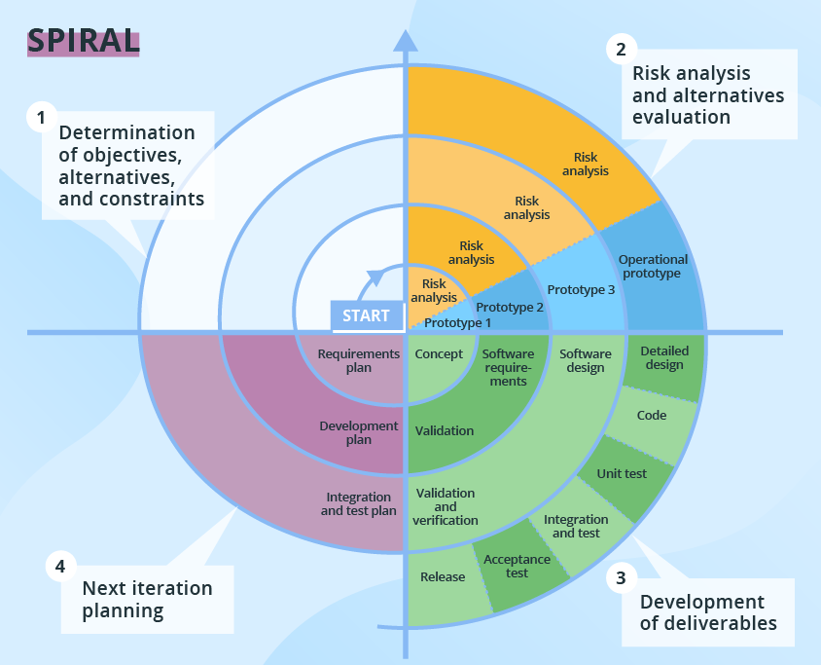
Software Development Life Cycle Examples
Waterfall
Agile
V-Model
Spiral
Notes:
Pete

Slide 19
Waterfall Software Development Life Cycle
Notes:
Pete

Slide 20
Requirements: What to Implement?
What should the system do ?
What are the needs of the users ?
What are the needs of the host organisation ?
What are interoperability needs of existing systems
We need to think about functional elements: what the system should do?
And also non-functional elements: quality properties of system operation, e.g., security, ease of use, response time etc.
Notes:
Pete

Slide 21
Design: How to Structure Software?
What objects, databases, servers, services etc. should we create?
How are these elements structured into a system?
Why to design?
Helps to decide where to place requirements
How the parts of the system will be interacting
Divide up work between team members
Notes:
Pete

Slide 22
Implementation
Not just programming, but also…
Parallel working and code sharing
API partitioning and “firewalling”
Versioning, integration and config management
Development environments and automated build
Automated testing
Docs and training material
Notes:
Pete

Slide 23
Verification and Validation
Verification: check if the software/service complies with a requirements, constraints, and regulations. ("Are you building it right?")
Demonstrates that system meets specifications
Validation: does this meet the needs of the customers/ stakeholders? ("Are you building the right thing?")
Demonstrate that system meets user needs
Can pass verification but fails validation: if built as per the specifications yes the specifications do not address the user's needs.
Involves checking, reviewing, evaluating & testing
Notes:
Pete

Slide 24
Waterfall SDLC: Advantages and Disadvantages
Simple to use and understand
Every phase has a defined result and process review
Development stages go one by one
Perfect for projects where requirements are clear and agreed upon
Easy to determine the key points in the development cycle
Easy to classify and prioritize tasks
The software is ready only after the last stage is over
High risks and uncertainty
Misses complexity due to interdependence of decisions
Not suited for long-term projects where requirements will change
The progress of the stage is hard to measure while it is still in the development
Integration is done at the very end, which does not give the option of identifying the problem in advance
Notes:
Pete

Slide 25
Review
What is Software Engineering about?
What is Software Development Life Cycle?
Can you name any Software Development Life Cycles?
What are the specific characteristics of Waterfall SDLC?
Notes:
Pete

